Slide 1
LSTM Approach for SMS Classification using Recurrent Neural Network
Guide Present by-
Mrs. Pranali Lokhande Arjun Yachwad(B194032)
Prashant Walunj(B194158)
Tushar Potale(B194140)
Pranav Dighe(B194152)

Slide 2
Content
Problem Statement
Introduction
Objective
Dataset
LSTM method
Output
Conclusion

Slide 3
Problem Statement
Short Message Service (SMS) is one of the mobile communication services that allows easy and inexpensive communication. Producing unwanted messages with the aim of advertising or harassment and sending these messages on SMS have become the biggest challenge in this service.
To minimize this problem we used An LSTM Approach for SMS Classification using Recurrent Neural Network.

Slide 4
Introduction
In recent years, the use of mobile phones and smart systems has increasingly developed, and Short Message Service (SMS) has become one of the most important means of communication; so that 97% of cell phone users use this service. Unwanted short messages (known as spams) are transferred on the communication channel such as SMS, perform great advertising, but as a disturbing factor for users
Of this large number of short messages, many are unwanted SMS messages produced for the following reasons.
Sending SMS is low cost and many mobile operators offer SMS packages with very low price.
Since users interact more with mobile phones compared to computers, they have more confidence in SMS, and it is very convenient to send confidential information

Slide 5
AIM:
To Reduce IT Administration Costs.
To Provide sensitivity to the client and adapts well to the future spam techniques.
To Reduce Network Resource Costs.
OBJECTIVE:
The objective of identification of Spam SMS are:
To give knowledge to the user about the fake SMS and relevant SMS.
To classify that mail spam or not.

Slide 6
Dataset
The SMS Spam Collection is a set of SMS tagged messages that have been collected for SMS Spam research. It contains one set of SMS messages in English of 5,574 messages, tagged according being ham (legitimate) or spam.
The files contain one message per line. Each line is composed by two columns: v1 contains the label (ham or spam) and v2 contains the raw text.

Slide 7
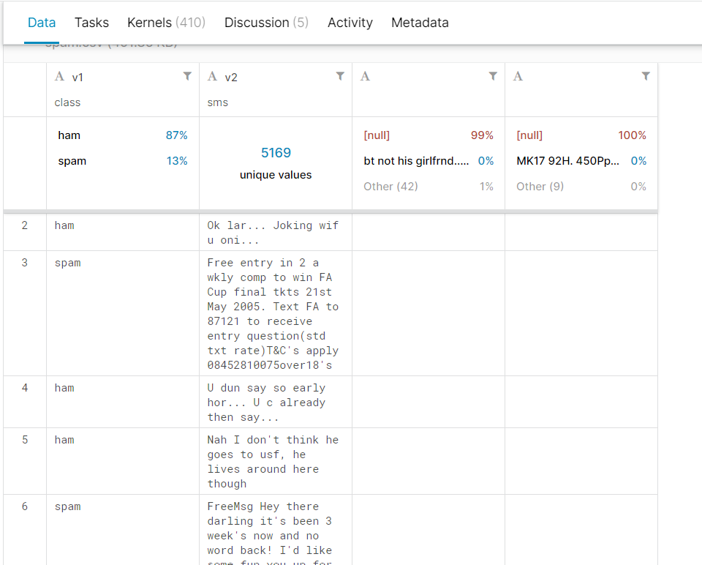

Slide 8
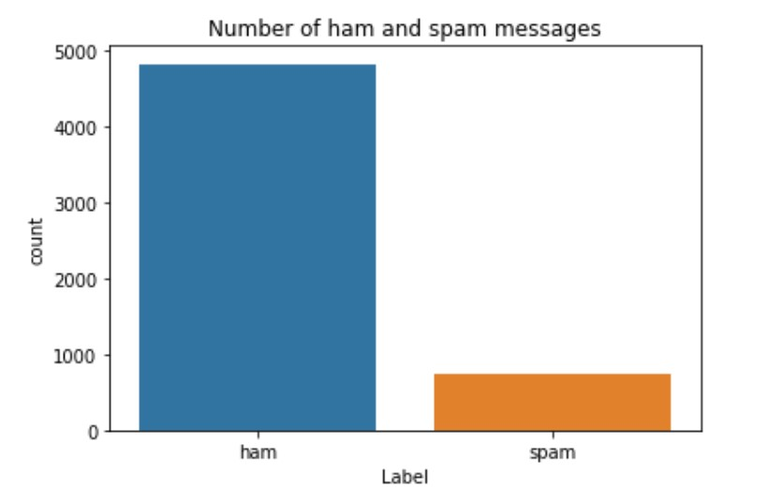
ham vs spam graph

Slide 9

LSTM Diagram

Slide 10
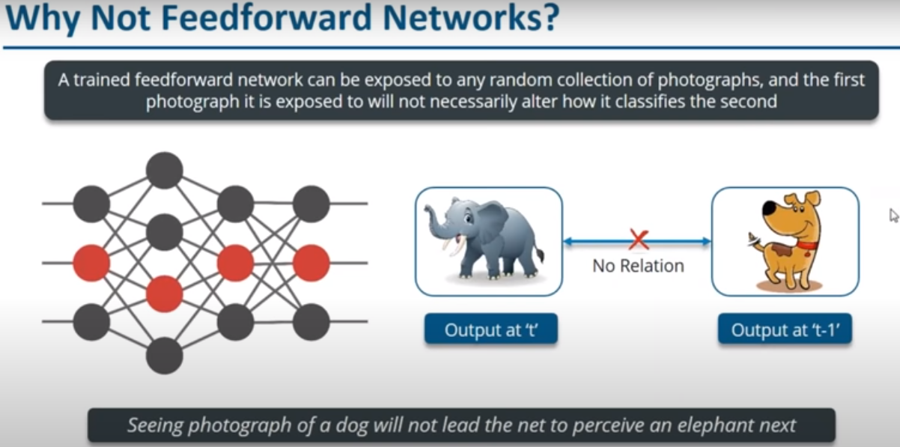

Slide 11
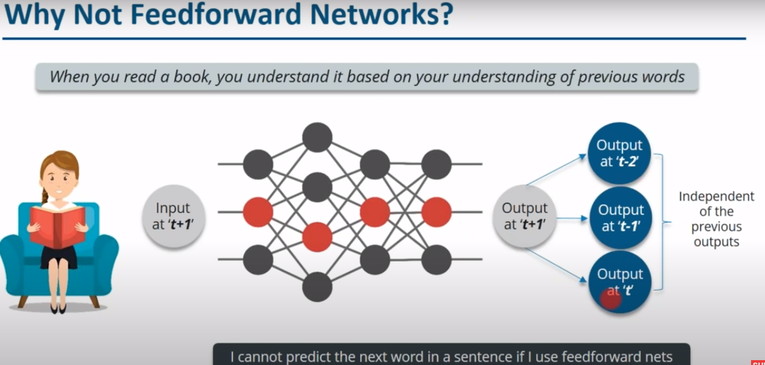

Slide 12
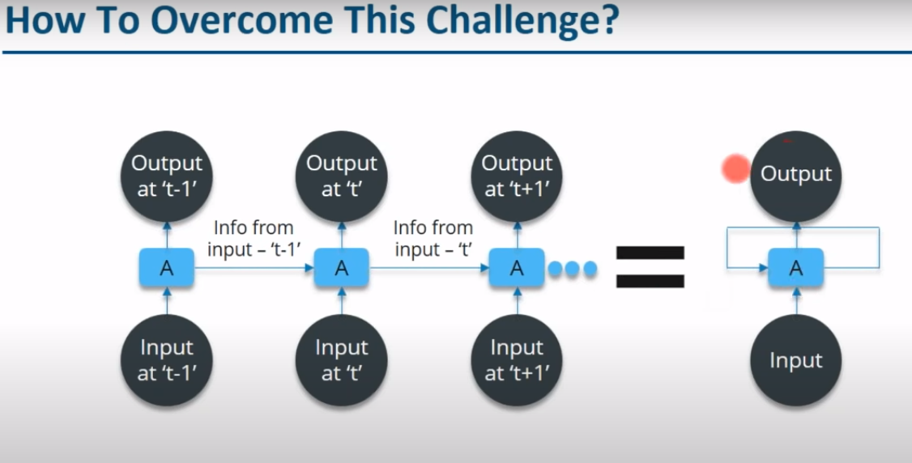

Slide 13
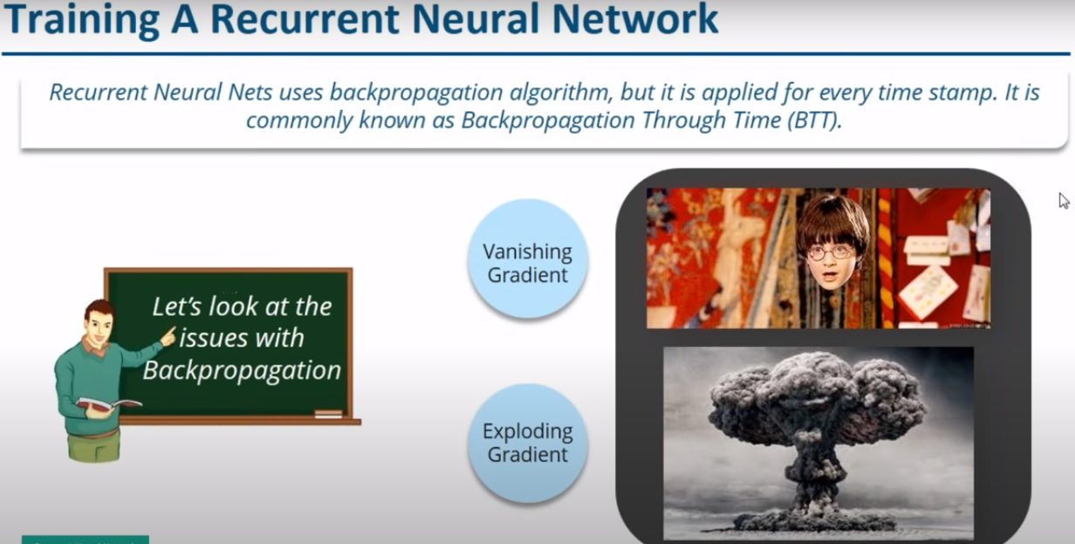

Slide 14
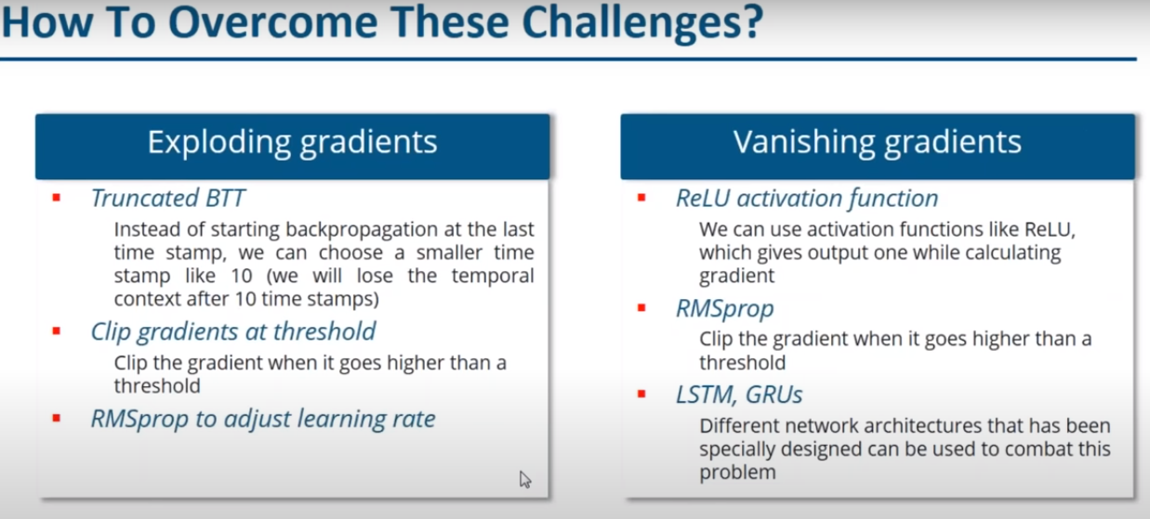

Slide 15
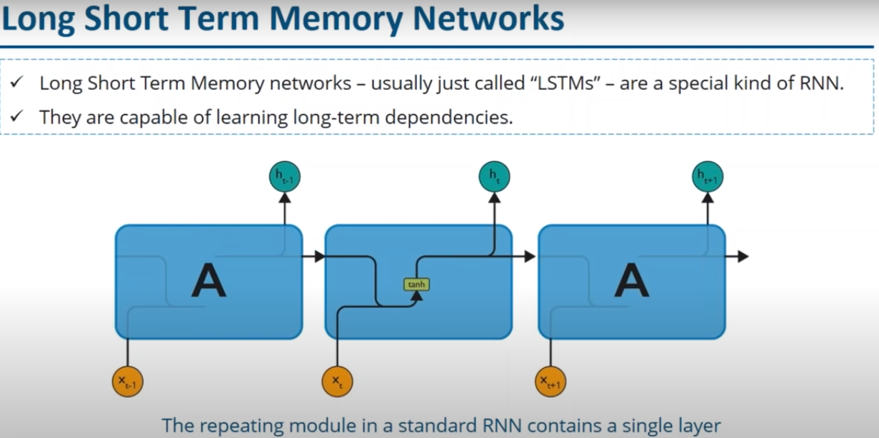

Slide 16
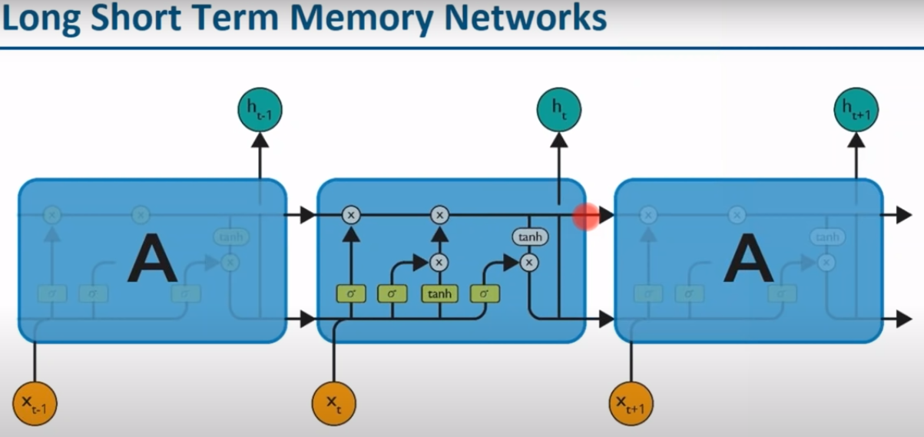

Slide 17
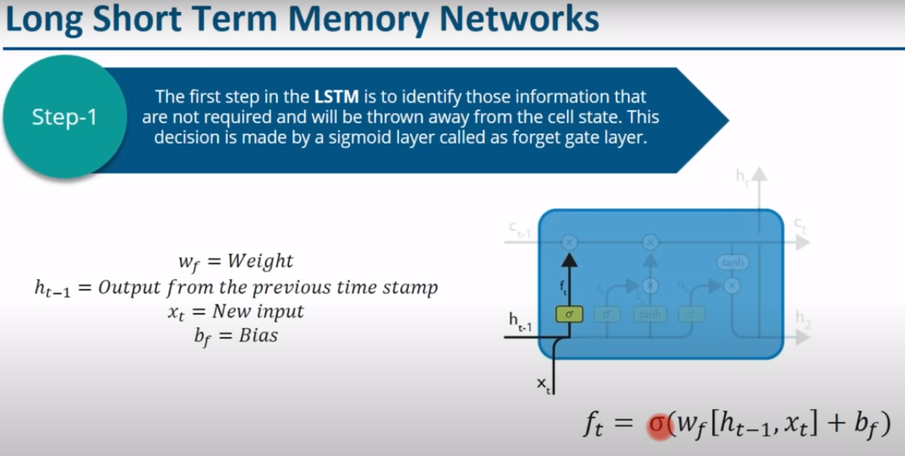

Slide 18
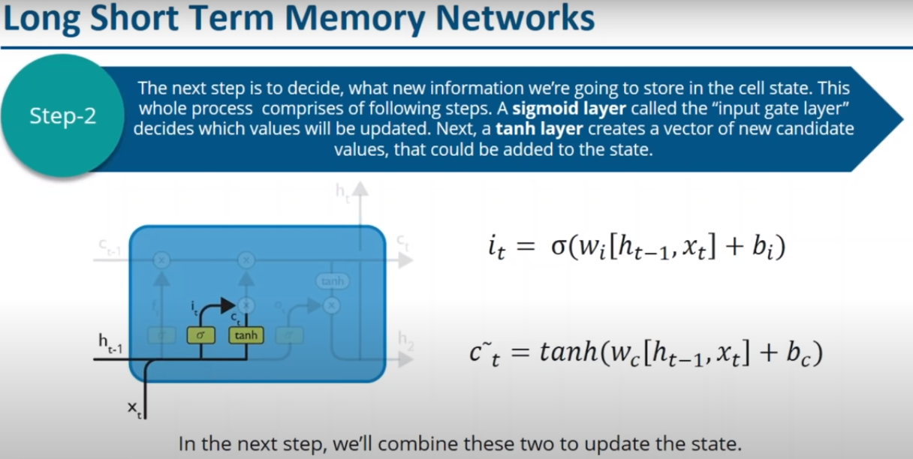

Slide 19
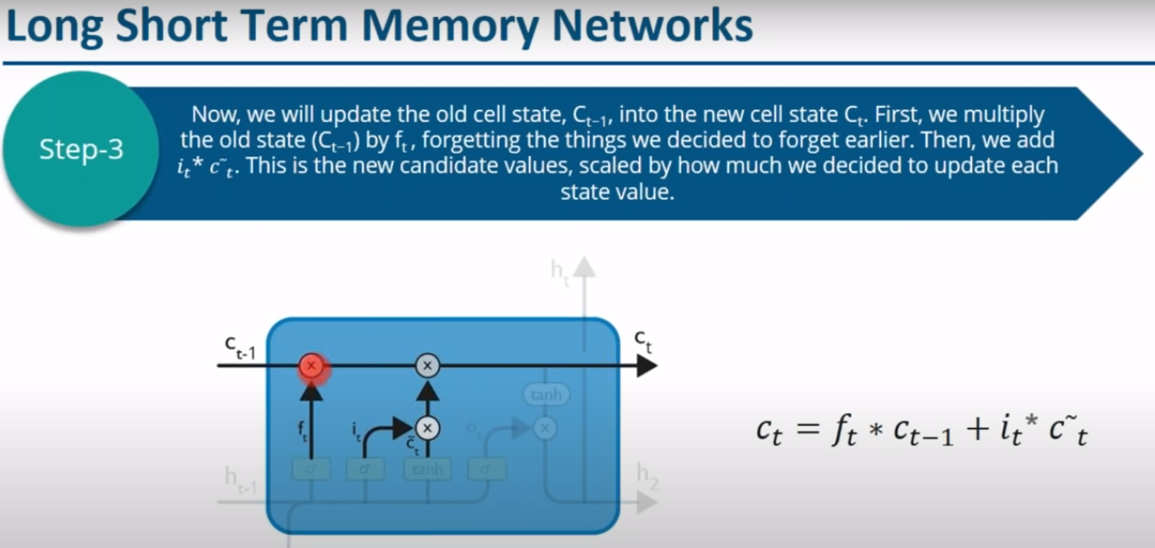

Slide 20
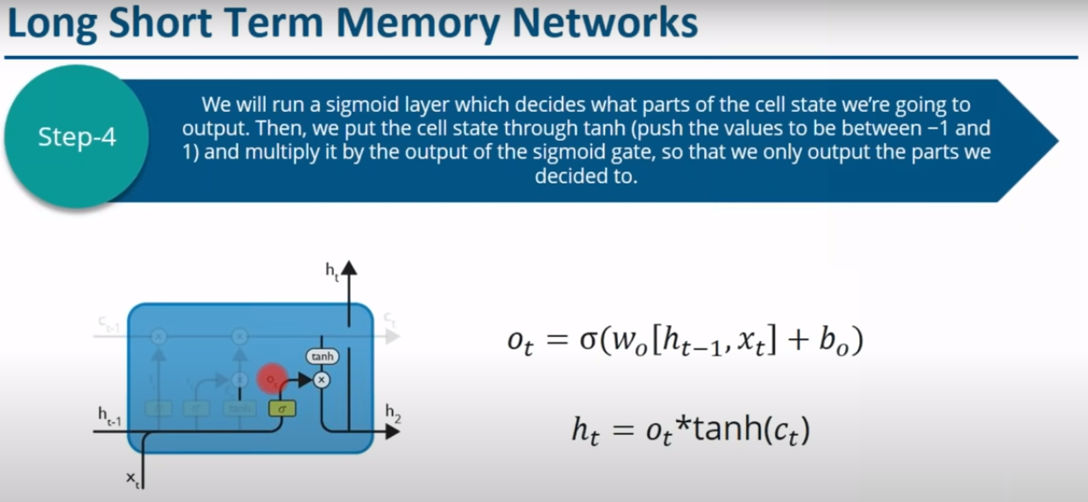

Slide 21
OUTPUT

Slide 22
Conclusion
we have proposed a classification approach based on LSTM for short texts in SMS. Using word embeddings such as Word2Vec model, it’s feasible to train the contextual semantics of words in short texts. Also, deep learning methods such as LSTM show better performance of sentiment classification when there are more amounts of training data. For special community behaviors, further experiments using “community”-specific sentiment lexicon and larger data sizes are needed in future.

Slide 23
Thank You…

